Slide 1
Selecting a Project
Create Performance Task

Slide 2
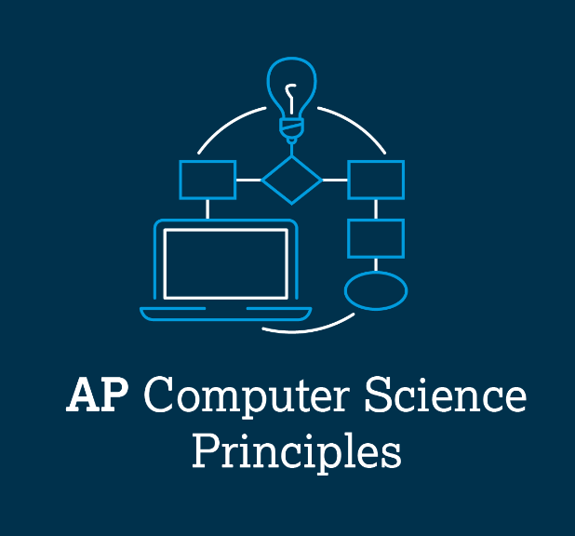
AP CSP Create Performance Task
Create PT specific requirements:
Has input (button presses)
Has output (screen, pixels, audio, etc.)
Creates a list
Uses a list in a meaningful way
Has a function with a parameter
Parameter has an effect on the functionality of the function (Parameter used in if statement)
Function has:
Selection (If statement)
Iteration (Loop)

Slide 3
AP CSP Create Performance Task
Things to remember about the Create PT:
You can work with a partner.
Your classmates can help you.
Your teacher cannot help you.
You cannot use an assigned program or Practice PT for your project, but it can be similar.
You will be given 9 hours of class time to work on the project.

Slide 4
AP CSP Create PT - Selecting a project
This lesson will help you come up with an idea for your Create PT project.
Throughout this course you have:
Created two remix projects
Completed four PT Practice programs
Modified one PT Practice program

Slide 5
AP CSP Create PT - Selecting a project
What can your project NOT be?
You CANNOT submit a project completed for an assignment.
This includes all the PT Practice programs.
This includes your remix programs.
This includes the mission programs.
Anything program you received feedback or help from the teacher cannot be submitted as your Create Performance Task.
The teacher cannot assign you a project. You must come up with your own idea.

Slide 6
AP CSP Create PT - Selecting a project
What can your project be?
Your project can be based on, or similar to, your other programs.
The Create PT needs to be original code, or have a significant extension to a previous program.
It doesn’t need to be a huge project with lots of complicated lines of code – just something that shows what you know and meets the requirements.
It should be something you are interested in.
Your teacher can help you brainstorm ideas, but your actual project is up to you!

Slide 7
AP CSP Create PT - Selecting a project
PT Practice #1
Go to the Sandbox in CodeSpace and open PT_Practice1.
Review what the code does.
Review how and where the code meets the PT requirements.

Slide 8
AP CSP Create PT - Selecting a project
PT Practice #1
What the program does:
This program lets the player select one of two lists, and it then traverses the list.
Brainstorm some new Create PT projects, based on this one.

Slide 9
AP CSP Create PT - Selecting a project
PT Practice #1
Brainstorm Ideas (add your own ideas to the list!)
Change the lists to text.
Select a topic, like your two favorite sports teams, songs from your two favorite musicians, characters from your two favorite shows, etc.
Let the player select which list to traverse. Then display the information.

Slide 10
AP CSP Create PT - Selecting a project
PT Practice #1
Brainstorm Ideas (add your own ideas to the list!)
Change the lists to JPG images.
Select a topic, like your two favorite sports teams, songs from your two favorite musicians, characters from your two favorite shows, etc.
Let the player select which list to traverse. Then display the information.

Slide 11
AP CSP Create PT - Selecting a project
PT Practice #1
Brainstorm Ideas (add your own ideas to the list!)
Add more lists. Instead of having two lists, try three or four.
Add a single item scroll option. Let the player:
Select a list
Then choose to either scroll each item one at a time (like Mission 7) or traverse all the items like a slideshow.
Add a random item option (like Mission 8).

Slide 12
AP CSP Create PT - Selecting a project
PT Practice #2
Go to the Sandbox in CodeSpace and open PT_Practice2.
Review what the code does.
Review how and where the code meets the PT requirements.

Slide 13
AP CSP Create PT - Selecting a project
PT Practice #2
What the program does:
This program lets the user play a button press game, with three levels of difficulty.
Brainstorm some new Create PT projects, based on this one.

Slide 14
AP CSP Create PT - Selecting a project
PT Practice #2
Brainstorm Ideas (add your own ideas to the list!)
Change the button press prompts.
Instead of text that says which button to press, use images (like arrows).
Change the text to colors. Players need to know which button each color represents.
Use the pixels to indicate which button to press. Buttons A and B also have an LED that can light.

Slide 15
AP CSP Create PT - Selecting a project
PT Practice #2
Brainstorm Ideas (add your own ideas to the list!)
Instead of giving the player a choice of levels, have them select the type of prompt:
Image prompt or text prompt.

Slide 16
AP CSP Create PT - Selecting a project
PT Practice #2
Brainstorm Ideas (add your own ideas to the list!)
Change the output. Instead of lighting pixels RED or GREEN:
Display an image for right and wrong
Add a counter that keeps track of correct presses. Then display a message at the end with their results.
You can even calculate the winning percentage.

Slide 17
AP CSP Create PT - Selecting a project
PT Practice #2
Brainstorm Ideas (add your own ideas to the list!)
Have more than one list, with buttons in different orders.
The CodeX can randomly select which list to traverse for the game.
Create a second list from the first list by mixing up the order of elements. Then traverse the new list for the game.

Slide 18
AP CSP Create PT - Selecting a project
PT Practice #3
Go to the Sandbox in CodeSpace and open PT_Practice3.
Review what the code does.
Review how and where the code meets the PT requirements.

Slide 19
AP CSP Create PT - Selecting a project
PT Practice #3
What the program does:
This program selects a random student from a class.
Brainstorm some new Create PT projects, based on this one.

Slide 20
AP CSP Create PT - Selecting a project
PT Practice #3
Brainstorm Ideas (add your own ideas to the list!)
Use it as a game spinner or card selection for two different games. Have two lists, for two different games. Possibilities include:
Random colors for the squares on an easy child game.
Text on a board game tile (like Life).
Game cards, like Monopoly.
Use it with numbers instead of rolling dice.
Get a random letter, like Bogle
Use images from a Bingo card and randomly select them.

Slide 21
AP CSP Create PT - Selecting a project
PT Practice #3
Brainstorm Ideas (add your own ideas to the list!)
Change the information in the lists. Besides randomly selecting a student, what else might you want to randomly select in a classroom setting:
Review questions (2 different sets)
Topic starter for a class discussion (2 different sets)
Setting for a story or poem OR writing style

Slide 22
AP CSP Create PT - Selecting a project
PT Practice #3
Brainstorm Ideas (add your own ideas to the list!)
Have something like a cooking competition
Have a list for proteins, another for veggies.
Randomly select a protein and two veggies a group has to use in a meal.

Slide 23
AP CSP Create PT - Selecting a project
PT Practice #3
Brainstorm Ideas (add your own ideas to the list!)
Use the program like flashcards
Have a list for the questions and a list for the answers.
The player can select a random question and say the answer, or select a random answer and say the question.
If the questions and answers are in the same order, you can even display the question/answer after a time limit.

Slide 24
AP CSP Create PT - Selecting a project
PT Practice #4
Go to the Sandbox in CodeSpace and open PT_Practice4.
Review what the code does.
Review how and where the code meets the PT requirements.

Slide 25
AP CSP Create PT - Selecting a project
PT Practice #4
What the program does:
This program plays a hand-eye coordination game with button presses.
Brainstorm some new Create PT projects, based on this one.

Slide 26
AP CSP Create PT - Selecting a project
PT Practice #4
Brainstorm Ideas (add your own ideas to the list!)
Change the list from single letters to something else:
Use pre-defined bitmap images
Use JPG images
Use words
Use numbers

Slide 27
AP CSP Create PT - Selecting a project
PT Practice #4
Brainstorm Ideas (add your own ideas to the list!)
Add a counter to keep track of total number of plays, and another counter for correct button presses.
Use this information to display results at the end.
Instead of selecting a speed for the game, add another list and let the player choose between a letter or an image.
Change the output. Instead of lighting pixels RED or GREEN:
Display an image for right and wrong

Slide 28
AP CSP Create PT - Selecting a project
Remix project and missions
Open a project that you really enjoyed.
What Create PT requirements does it already meet?
What can you add to it to meet all the requirements?
How can you modify the program to add new functionality?

Slide 29
AP CSP Create PT - Selecting a project
You should fully understand the requirements of the Create PT and are ready to start brainstorming an idea for your project.
You will be given class time to complete the project.
You should be able to complete the code in 7 hours (don’t make it too complicated).
Then you will have 2 hours for the Digital Portfolio.
No new programming skills – This isn’t the time to learn something new.
Stick with what you already know and make it work.

Slide 30
AP CSP Create PT - Selecting a project
Pick a project that:
Is personally relevant – a project you are interested in
Has a clear purpose
Can meet all the requirements of the Create PT
It is helpful if the project:
Has a detailed introduction or menu of options.
Tell the user what buttons to use, and for what.
Has some kind of ending.

Slide 31
AP CSP Create PT - Selecting a project
Final Comments
Don’t use any code that you don’t understand. The Create PT is all about the writing. If you can’t explain it, don’t use it.
Work with a partner! Do equal work, and make sure you both understand the code.
You can get feedback and help from your peers. That means all the students in your class, but no one else.
DO NOT ask the teacher for any help, other than technical, during the Create PT class hours.

Slide 32
AP CSP Create PT - Selecting a project
Final Comments
Have a plan.
You can use the remix planning guide, or any other organizer, to help you.
Get the basics done first. Make sure you have input, output and a list.
Go step-by-step. Test as you go, and debug frequently.
Then, if you have time, add more functionality.

